Slide 1

Data Mining on a Spent Fuel Pool Accident Scenario
RAVEN Workshop
Presenter: Diego Mandelli
IRUG Meeting – Idaho Falls, October 2016

Slide 2
Outline
Overview of RAVEN Data Mining Capabilities
Time-Dependent Data Mining
Pre-Processing
Metrics
Data Representation
Spent Fuel Pool Test Analysis

Slide 3
RAVEN Data Mining Capabilities
Clustering
Partition data set given a similarity metrics (distance)
Reduced Order Modeling
Create a math model that describes the data set
Dimensionality Reduction
Reduce data set dimensionality
These capabilities can be applied to both static and time-dependent data sets

Slide 4
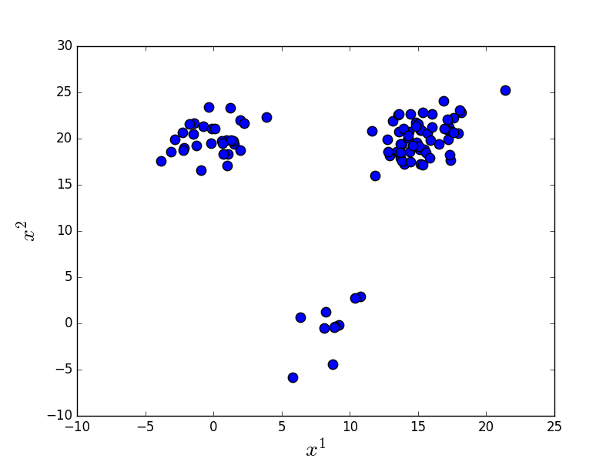
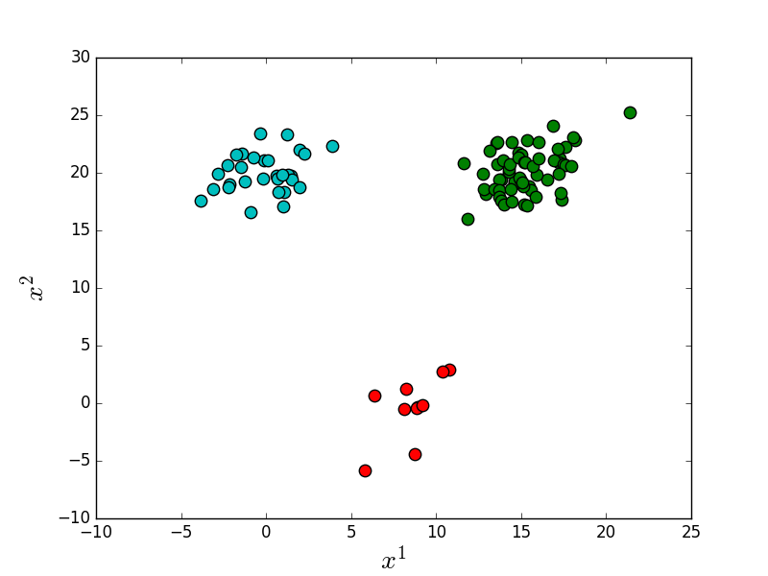
Clustering: Static Data
Static data
Input parameters: double, int
E.g., friction coefficient
Output parameters: double, int
E.g., max clad temperature
Algorithms available include
Hierarchical
Mean-Shift
K-Means
Applications
Analysis of data input-output relationship
Outlier identification

Slide 5
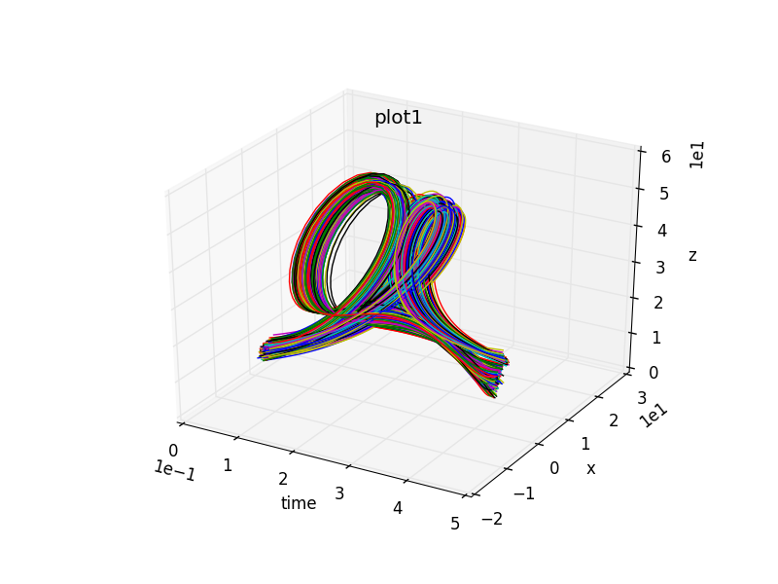
Clustering: Time-Dependent Data
Time-dependent data
Input parameters: double, int
E.g., friction coefficient
Output parameters: array of double, int
E.g., clad temperature temporal profile
Same clustering algorithms
Challenges
Different time lengths
Distance metrics
Sensitive to data pre-processing

Slide 6
Clustering in RAVEN
Minkowski
Mahalanobis
custom
…
Static Metrics
Distance Matrix Clustering
Hierarchical
DBSCAN
Static data
Hierarchical
K-Means
Mean-Shift
DBSCAN
…
Clustering
Pre-Processing
Real value
Polynomial
Hermite
Chebyshev
Laguerre
Legendre
SVD
Fourier
Raw data
Re-Sampling
Data Representation
Time-dependent data
Distance Matrix Clustering
Hierarchical
DBSCAN
Minkowski
DTW
custom
Time-Dependent Metrics
Hierarchical
K-Means
Mean-Shift
DBSCAN
…
Time step based Clustering

Slide 7
Clustering in RAVEN: Static Data
Distance Matrix Clustering
Given N data points
Clustering input is a NxN dimensional matrix
is the distance between the i^{th} and j^{th} data points
Minkowski
Mahalanobis
custom
…
Static Metrics
Distance Matrix Clustering
Hierarchical
DBSCAN
Static data
Hierarchical
K-Means
Mean-Shift
DBSCAN
…
Clustering
Pre-Processing
Raw data

Slide 8
Clustering in RAVEN: Time-Dependent Data (1)
Objective: employ algorithms already available in RAVEN
Convert time-dependent data into static data (D-dimensional vector)
Time series is approximated by a series of basis functions
Coefficients c_{d} are retained as representatives for the time series
Static data
Hierarchical
K-Means
Mean-Shift
DBSCAN
…
Clustering
Pre-Processing
Real value
Polynomial
Hermite
Chebyshev
Laguerre
Legendre
SVD
Fourier
Raw data
Re-Sampling
Data Representation
Time-dependent data

Slide 9
Clustering in RAVEN: Time-Dependent Data (2)
Distance Matrix Clustering
Given N time series
Input is a NxN dimensional matrix D
is the distance between the i^{th} and j^{th} time series
Pre-Processing
Raw data
Re-Sampling
Time-dependent data
Distance Matrix Clustering
Hierarchical
DBSCAN
Minkowski
DTW
custom
Time-Dependent Metrics

Slide 10
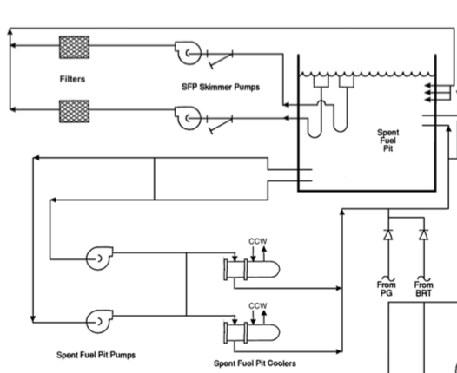
SFP Analysis
Model
NPP SFP
Cooling system
Modeled using RELAP5-3D
Initiating event
Seismic induced SFP break

Slide 11
SFP Analysis
Scenario
SFP Break (LOCA) + pump failures + recovery
5 stochastic variables
Pump 1 failure
Pump 2 failure
LOCA time
LOCA size
Operator recovery

Slide 12
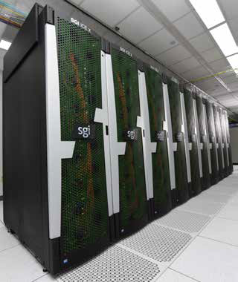


SFP Analysis: Workflow
Sample model
Creation of 2000 RELAP5-3D SFP simulations
HPC environment (falcon2.inl.gov)
Time: about 9 hours
Create database
Load database
Clustering of time-series
Mac laptop
Time: about 20min
Data analysis

Slide 13
SFP Analysis: RAVEN Data Mining Ingredients
Step: PostProcess
Metrics
Models
HistorySetSampling
DataMining (sklearn or scipy)
dataObjectLabelFilter
DataObject: HistorySet
Label=1
Label=2
Label=3

Slide 14
SFP Data Analysis
Load database

Slide 15
SFP Analysis: Load Database
<Steps>
...
<IOStep name="dataRetrieve">
<Input class="Databases" type="HDF5" >DBB_RELAP5</Input>
<Output class="DataObjects" type="HistorySet" >HistorySetRaw</Output>
</IOStep>
...
</Steps>
<Databases>
<HDF5 name="DBB_RELAP5" filename="DBB_RELAP5.h5" readMode="read"/>
</Databases>

Slide 16
SFP Data Analysis
Load database
Pre-processing

Slide 17
SFP Analysis: Pre-Processing
<Steps>
...
<PostProcess name="preProc">
<Input class="DataObjects" type="HistorySet" >HistorySetRaw</Input>
<Model class="Models" type="PostProcessor" >HSsampling</Model>
<Output class="DataObjects" type="HistorySet" >HistorySetPP</Output>
</PostProcess>
...
</Steps>
<Models>
...
<PostProcessor name="HSsampling" subType="InterfacedPostProcessor">
<method>HistorySetSampling</method>
<samplingType>uniform</samplingType>
<numberOfSamples>20</numberOfSamples>
<timeID>time</timeID>
<interpolation>linear</interpolation>
</PostProcessor>
...
</Models>

Slide 18
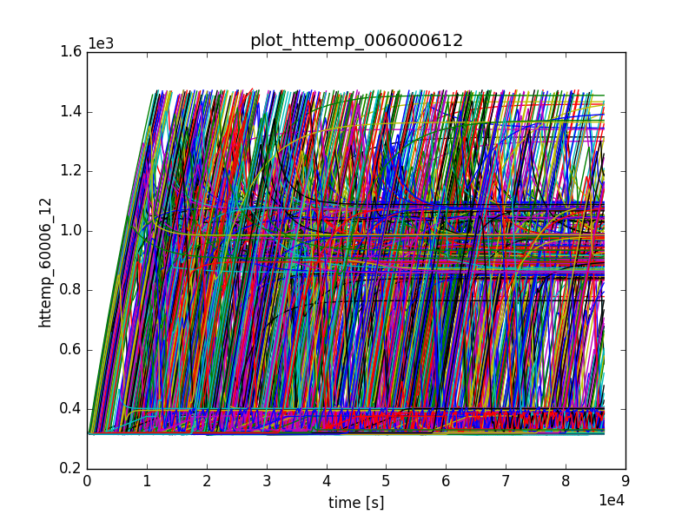
SFP Data Analysis
Load database
Pre-processing
Clustering (1)

Slide 19
SFP Analysis: Clustering (1)
<Steps>
...
<PostProcess name="preProc">
<Input class="DataObjects" type="HistorySet" >HistorySetPP</Input>
<Model class="Models" type="PostProcessor" >hierarchical</Model>
<Output class="DataObjects" type="HistorySet" >HistorySetPP</Output>
</PostProcess>
...
</Steps>
<Models>
...
<PostProcessor name="hierarchical" subType="DataMining">
<Metric class="Metrics" type="DTW">dtw</Metric>
<KDD lib="Scipy" labelFeature="labels">
<Features>time,httemp_60008_12</Features>
<SCIPYtype>cluster|Hierarchical</SCIPYtype>
<method>single</method>
<metric>euclidean</metric>
<level>2200</level>
</KDD>
</PostProcessor>
...
</Models>

Slide 20
SFP Data Analysis
Load database
Pre-processing
Clustering (1)

Slide 21
SFP Analysis: Filtering (1)
<Steps>
...
<PostProcess name="preProc">
<Input class="DataObjects" type="HistorySet" >HistorySetPP</Input>
<Model class="Models" type="PostProcessor" >filter2</Model>
<Output class="DataObjects" type="HistorySet" >HistorySet2</Output>
</PostProcess>
...
</Steps>
<Models>
...
<PostProcessor name="filter2" subType="InterfacedPostProcessor">
<method>dataObjectLabelFilter</method>
<dataType>HistorySet</dataType>
<label>labels</label>
<clusterIDs>2</clusterIDs>
</PostProcessor>
...
</Models>

Slide 22
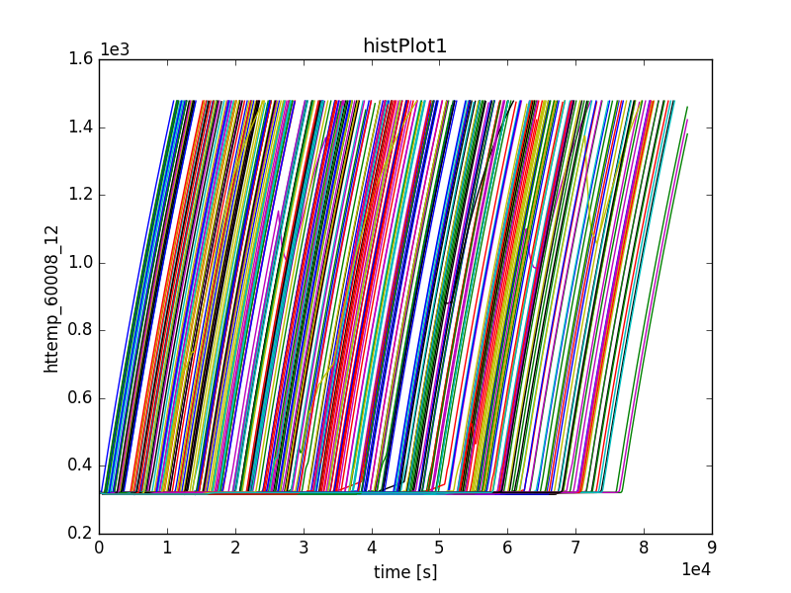
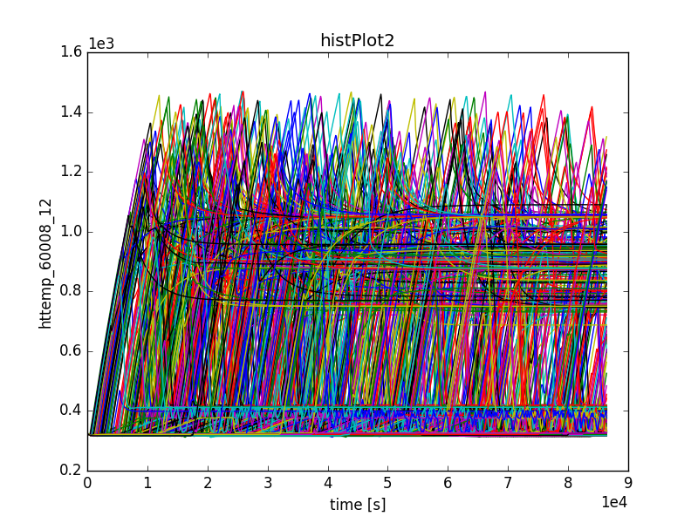
SFP Analysis: Filtering (1)
1st cluster
All scenarios leading to clad damage
About 6 “false positives”
Not leading to clad damage
Mission time reached right before reaching failure
2nd cluster
All scenarios leading to system success
Several sub-trends can be identified
Sub-clustering is then performed

Slide 23
SFP Data Analysis
Load database
Pre-processing
Clustering (1)
Input-Output Analysis
Clustering (2)

Slide 24
SFP Analysis: Clustering (2)
<Steps>
...
<PostProcess name="preProc">
<Input class="DataObjects" type="HistorySet" >HistorySet2</Input>
<Model class="Models" type="PostProcessor" >hierarchical2</Model>
<Output class="DataObjects" type="HistorySet" >HistorySet2</Output>
</PostProcess>
...
</Steps>
<Models>
...
<PostProcessor name="hierarchical2" subType="DataMining">
<Metric class="Metrics" type="DTW">dtw</Metric>
<KDD lib="Scipy" labelFeature="labels">
<Features>time,httemp_60008_12</Features>
<SCIPYtype>cluster|Hierarchical</SCIPYtype>
<method>single</method>
<metric>euclidean</metric>
<level>1450</level>
</KDD>
</PostProcessor>
...
</Models>

Slide 25
SFP Data Analysis
Load database
Pre-processing
Clustering (1)
Input-Output Analysis
Clustering (2)

Slide 26
SFP Analysis: Filtering (2)
<Steps>
...
<PostProcess name="preProc">
<Input class="DataObjects" type="HistorySet" >HistorySet2</Input>
<Model class="Models" type="PostProcessor" >filter1</Model>
<Output class="DataObjects" type="HistorySet" >HistorySet2_1</Output>
</PostProcess>
...
</Steps>
<Models>
...
<PostProcessor name="filter1" subType="InterfacedPostProcessor">
<method>dataObjectLabelFilter</method>
<dataType>HistorySet</dataType>
<label>labels</label>
<clusterIDs>1</clusterIDs>
</PostProcessor>
...
</Models>

Slide 27
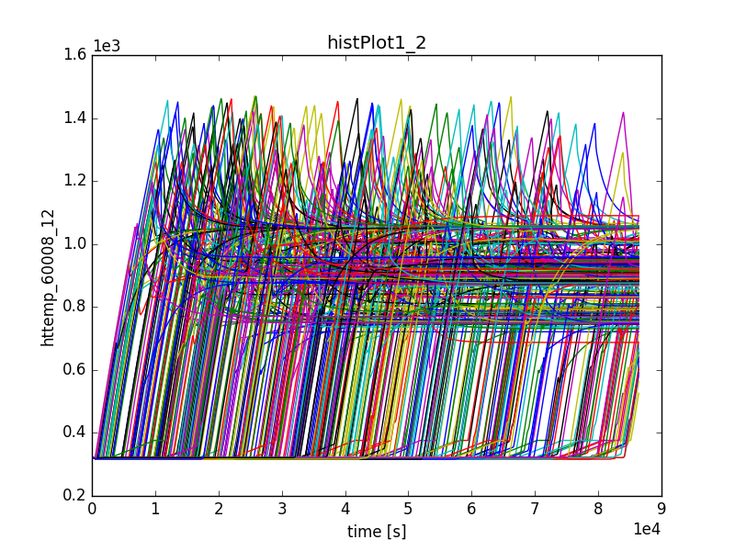
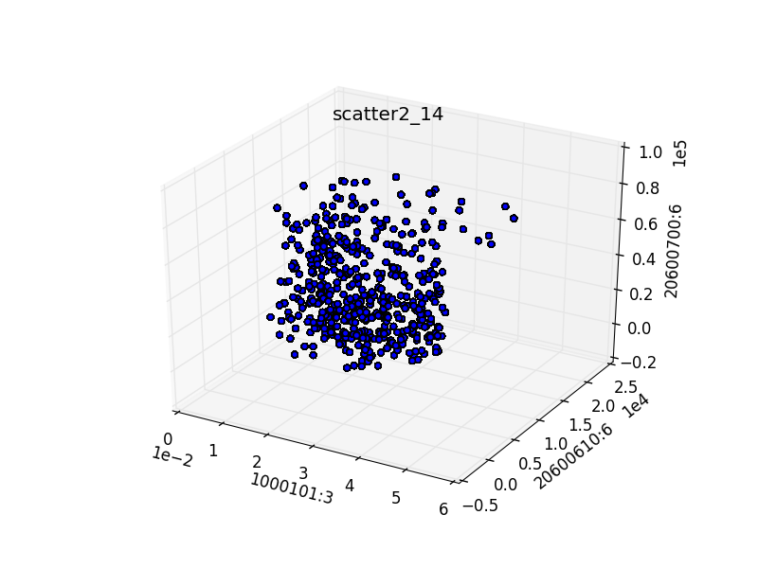
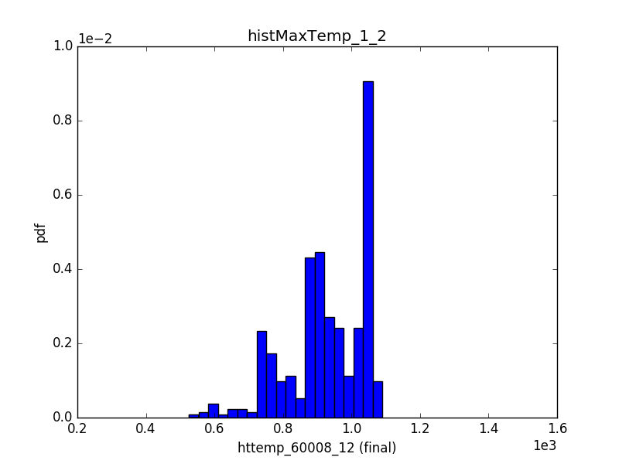
SFP Analysis: Filtering (2)
2nd cluster
Higher final clad temperatures
Central region of LOCA size
Low values of LOCA time
LOCA time
Operator action
LOCA size

Slide 28
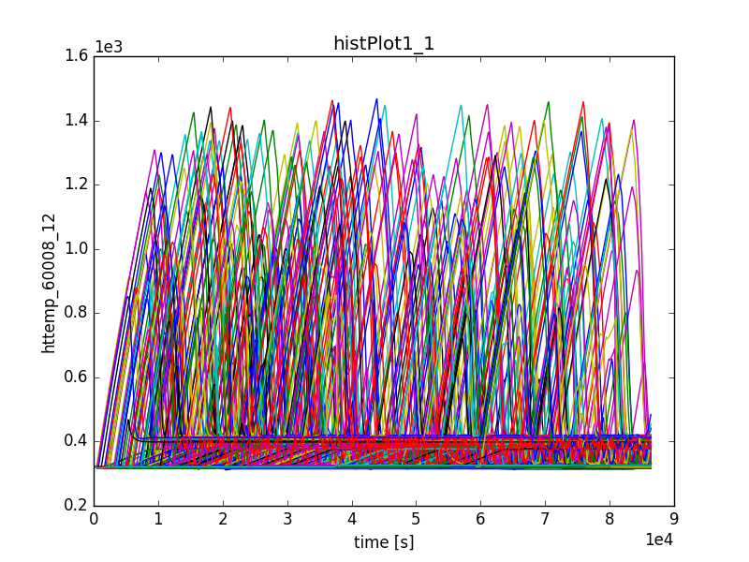
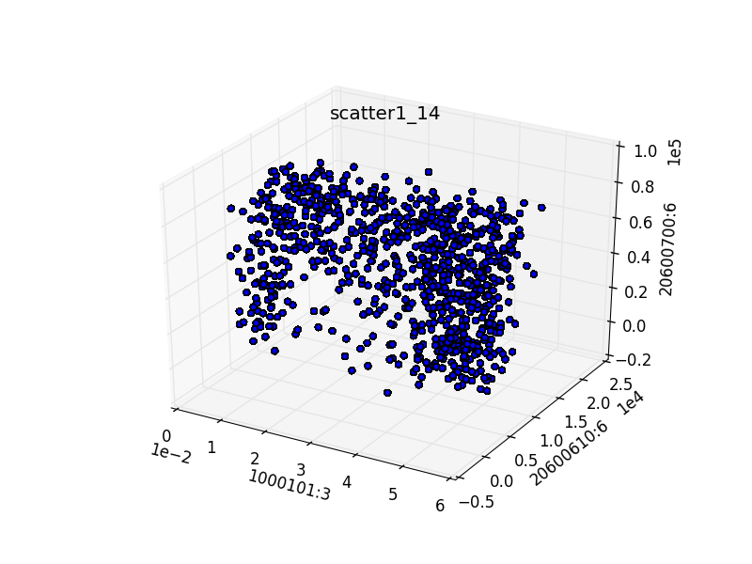
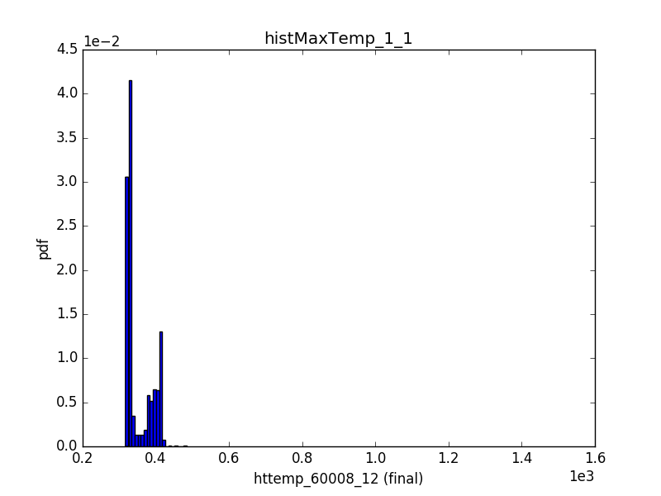
SFP Analysis: Filtering (2)
1st cluster
Lower final clad temperatures
Extreme values for LOCA size
High value of LOCA time
LOCA time
Operator action
LOCA size

Slide 29
Summary
Load database
Pre-processing
Clustering (1)
Input-Output Analysis
Clustering (2)
Input-Output Analysis
Input-Output Analysis

